Slide 1
Mastering the user experience with bots

Slide 2
Asking the user for simple information
Notes:
Show text prompts

Slide 3
Hello?
Hi there! I’m the Conference Bot!
???

Slide 4
I'd like to book a room for Bot Conference. I need a single occupancy king-sized room, checking in on Tuesday and checking out on Friday.
Sure thing!

Slide 5
One of the mistakes many people make when first working with bots is they focus in on the fact that it's a text-forward interface and expect people to then type everything in, which can lead to trouble, as most people aren't strong when it comes to typing, especially when they're on a small keyboard, such as a smartphone, and dealing with things like autocorrect, where correct words might be replaced with others, and as a result they really try to avoid typing an awful lot, and a user interface that requires them to say something like "I would like to report a runner in the race along the Pacific Northwest on Sunday at 8AM in Leg 25" would do nothing but frustrate that user and cause them to look somewhere else when it comes time to perform various operations because the experience they would have would not be what they were looking for, because when you stop to think about it having to type a lot of information into any application, especially when you're dealing with a small keyboard, isn't the way to go for a good application design, and you need to remember that the most common place people will be using bots is on such devices, because bots are designed to meet users where they're at, such as on Facebook Messenger, which is absolutely going to be on their phone more commonly than it would be on a desktop, although even having a real keyboard in front of you isn't necessarily going to make that type of an interface the best it could possibly be because not everyone can type 60 words per minute, and even those than can really don't want to be typing all of that onto a keyboard, especially when a simple set of buttons can do the job better than typing can.

Slide 6
tl;dr
Buttons are a good thing

Slide 7
Bots do not need any of the following
Machine Learning
Artificial Intelligence
Natural Language Processing
Speech Recognition

Slide 8
Pattern: Menu breakdown
So instead:
Hello user! How can I help you?
What types of events are you interested in?
What music would you like?
(By the way, next time you could just type “I’m looking for music events” and I will know what to do.)
Events
Music
Stages
Comedy
Amenities
Film
Laser Dome
Spectacles
Theater

Slide 9
Using menus
Guide the user
Channels often offer specialized menus, quick actions, etc.
Help the user discover what your bot can do
Read more

Slide 10
Guiding the user
Notes:
Show:
Choice
Confirm
Buttons in cards

Slide 11
Dialogs
Reusable modules
Perform a single operation
Callable from other dialogs
Can be made "global"

Slide 12
Register
CancelRoom
SubmitSession
CancelRegistration
PartyRegistration
FindSession
CheckRegistration
EventInformation
ChangeSession
LodgingInformation
SessionInformation
CancelSession
BookRoom
SpeakerInformation
PostPhoto

Slide 13
Dialog stack
GetDietaryRestrictions
Vegan
GetAttendeeInfo
Data
Register

Slide 14
Some basic facts about humans
Humans need guidance
Humans are complex
Humans can be random
Humans don’t fit a pattern

Slide 15
I'd like to make a lunch reservation for
two people
Absolutely! I have 11:30 and 12:30 available. What timeslot would you want?
Do you have a vegan menu?

Slide 16
Creating global handlers
Node.js
triggerAction
Set matches to either a regex or the name of an intent
(You'll actually use this to start most dialogs)
C#
Implement ScorableBase
PrepareAsync method looks for text or intent

Slide 17
Providing help
Notes:
Show:
Scorables
triggerAction

Slide 18
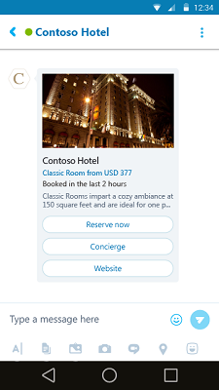
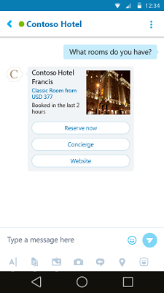
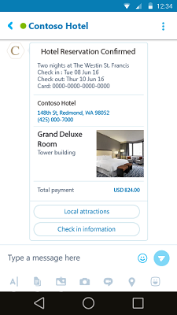
Bots are more than just text interfaces
Hero
Thumbnail
Receipt

Slide 19
Built-in card types
Framework provides several card times
Node.js
.NET
Send rich media
Images
Video
Audio
Not supported by all channels
Channels may have different implementations
Can almost be considered a "suggestion" to the channel

Slide 20
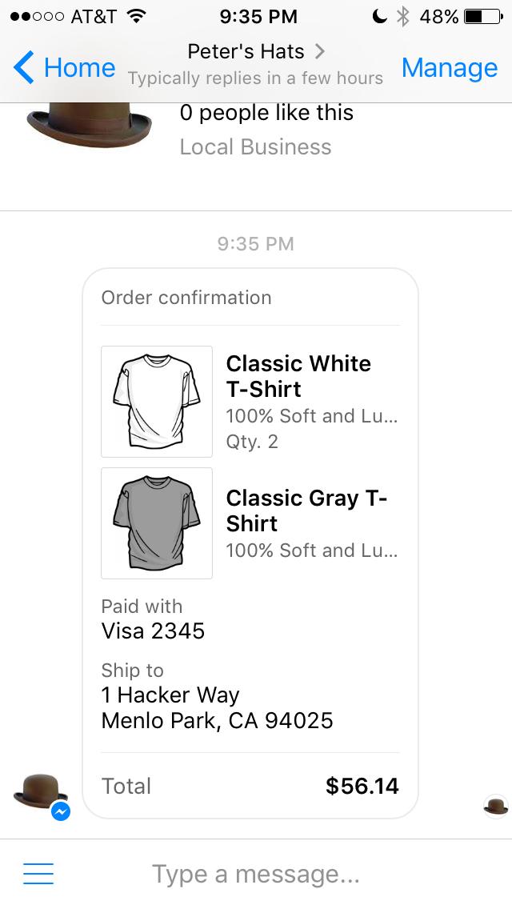
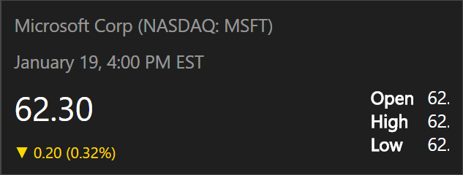
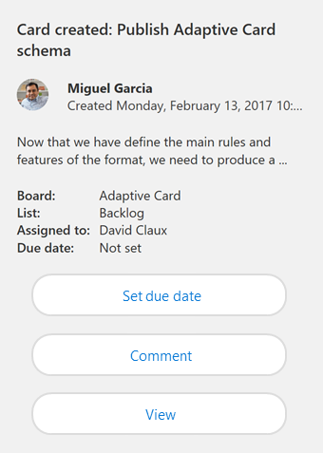
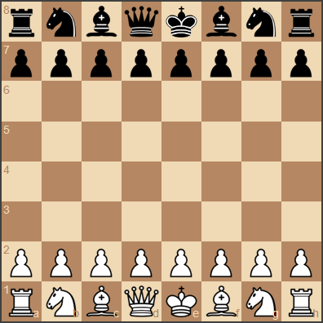
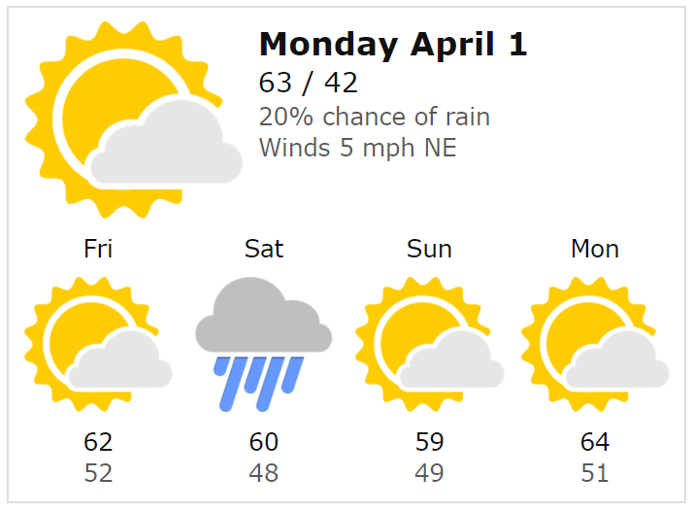
Filling the middle ground
Fixed templates
Complete control
No flexibility
Update Treadmill
Adaptive Cards
Flexible enough payload to cover 80% of needs
Host maintains strong control over style and security
Html Canvas
No consistency
No control
Security issues

Slide 21

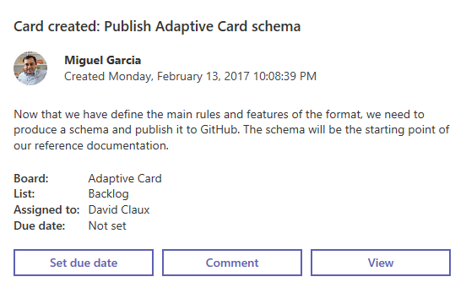
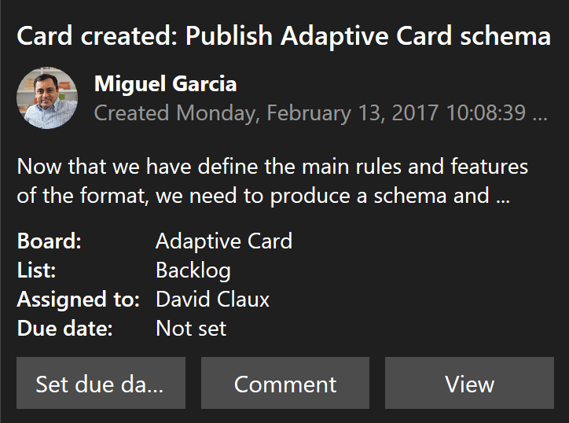
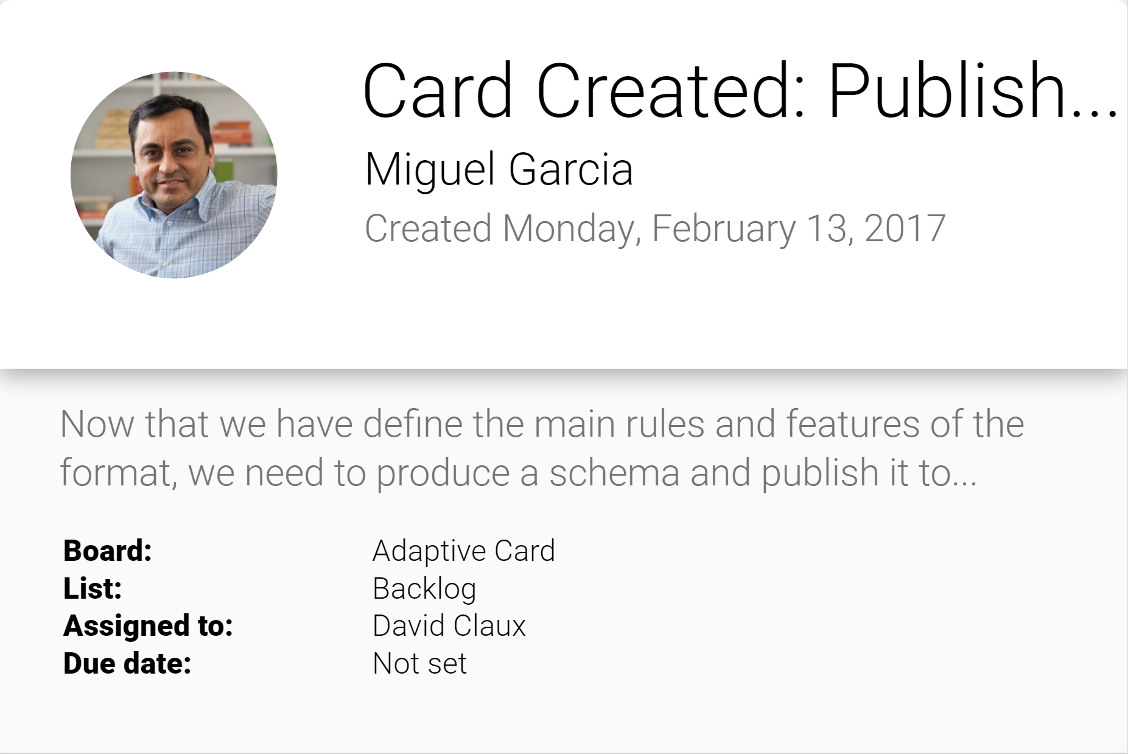
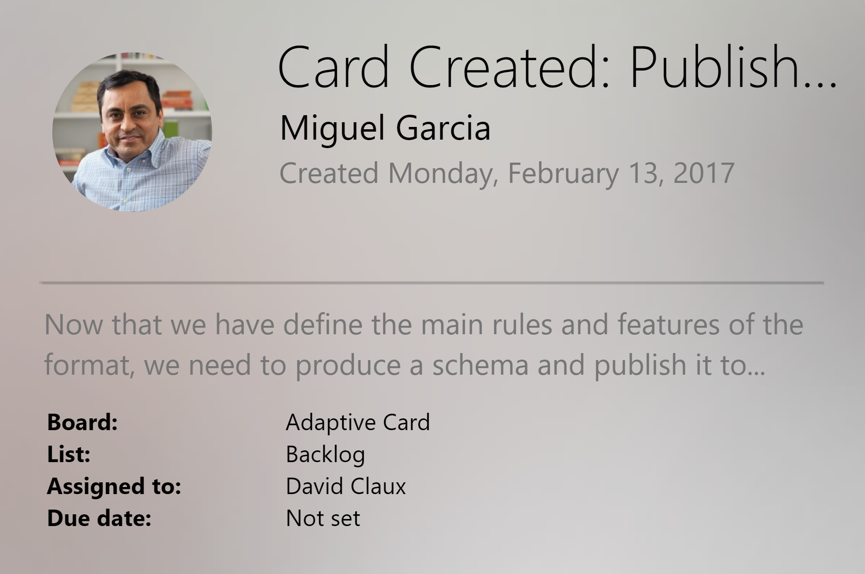
Adaptive Cards
Open FRAMEWORK
Multiple canvases
Notifications
Microsoft Teams
Skype
Android
iOS

Slide 22
Creating your own cards
Notes:
Show:
adaptivecards.io
Code to create adaptive cards

Slide 23
Your turn…
Update your bot to:
Allow users to enter trouble tickets
Category
Severity
Description
Confirm that all information is correct
Send the ticket displayed as a card

